Slide 1
Swiss re overview, contract highlights & Impm process
By
PRIYANKA D

Slide 2
SWISS RE OVERVIEW

Slide 3
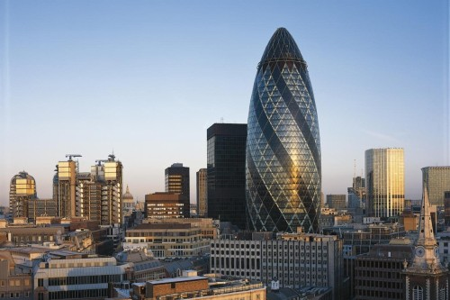
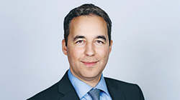

Swiss re
leading Reinsurance company founded in Zurich, Switzerland on 19th dec,1863

Slide 4
Evolution of relationship
Supported Customer integration
Insurance domain trainings & AICPCU certifications
Setup of SAP applications support center
Implementation of uniform SAP HR platform globally – multi year program
Moved to Performance based model from capacity based on SAP Support.
Assisted with decommissioning large portfolio of applications
Converted all T&M projects to FP.
Program based on COSM model rolled-out
Ramped up to 325 and successfully executed 75/25 model.
Setup of Plumtree CoE
Engagement
kick-off.
Setup of Centura / Mainframe CoE
2007
2006
COMRS
2005
2004
2003
2001
2002
2000
2008
2009
2010
2015
2016
Signed $25m volume contract
Setup of eFactory.
Setup of
DW/BI/Reporting CoE (Informatica & Cognos)
J2EE/TIBCO CoE
Increased offshore leverage.
Setup of the Rapid Response Team
Adopted new GEIS Tech Stack, (Plumtree, SAP XI, Documentum)
Setup of Documentum and SAP XI CoE
Supported IS portfolio integration with Customer.
Setup of dedicated infrastructure.
LOMA certifications
Setup Capacity Based Model for SAP Support.
Moved to Managed Services Model for SAP Support program and Corporate Functions support program

Slide 5
Contract highlights

Slide 6
Contract overview
Support Model – Consolidated Optimized Managed RUN Services (COMRS)
COMRS is created with an objective to provide a single window of support for the applications in scope.
This model drives toward customer focus on outcome and service predictability rather than resources/technology/ management and infrastructure with a standard and matured, optimized RUN services.

Slide 7
IMPM Process

Slide 8

Scope
All incidents and problems which are ONLY a part of OPERATIONS RUN TEAM

Slide 9

Types of tickets
Incident ticket
Incident
Inquiry
Event
feedback
problem ticket
Reactive
proactive

Slide 10
Ticket priority
Critical
high
medium
standard

Slide 11

Incident Management process
In Progress
Waiting For
Customer
Dependency
Resolved
closed

Slide 12

Problem management process
Problem management initiation
problem management priority
open
in analysis
waiting for change
resolved

Slide 13


